Slide 1
Capstone Project
Hotel Booking Analysis
Prepared by:
Hiba Iqbal

Slide 2








OBJECTIVE
Understanding the relationship between various factors affecting hotel room prices, hotel demand and prices.
Resort
City

Slide 3



VARIABLES
1. Hotel
3. lead_time
Resort
City
2. is_canceled

Slide 4




VARIABLES
4. arrival_date_year / arrival_date_month
5. stays_in_weekend_nights / stays_in_week_nights

Slide 5



VARIABLES
6. Adults / children / babies
7. meal
8. country

Slide 6

VARIABLES
9. market_segment / distribution_channel
10. is_repeated_guest

Slide 7
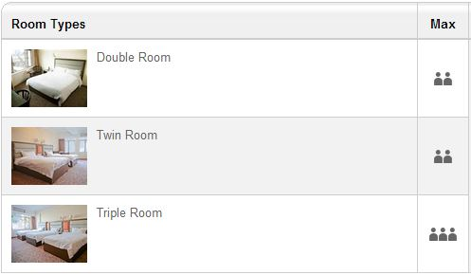
VARIABLES
11. previous_cancellations
12. reserved_room_type / assigned_room_type

Slide 8

VARIABLES
13. booking_changes
Number of times a booking was modified
14. deposit_type
15. days_in_waiting_list

Slide 9


VARIABLES
16. required_car_parking
Number of car parking required in one booking
17. total_of_special_requests
Number of special requests in one booking
18. reservation_status / reservation_status_date

Slide 10
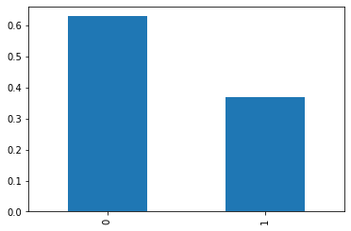
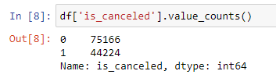
UNIVARIATE ANALYSIS
1. is_canceled

Slide 11
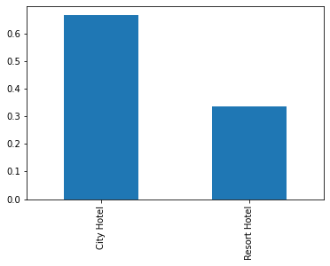
UNIVARIATE ANALYSIS
2. hotel
3. is_canceled

Slide 12
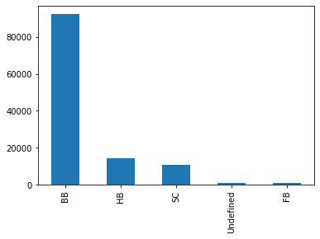
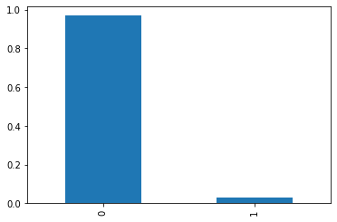
UNIVARIATE ANALYSIS
4. meal
5. is_repeated_guest

Slide 13
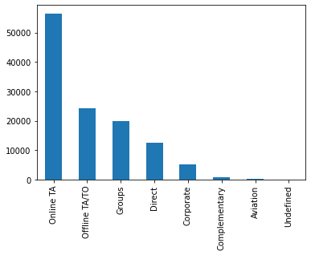
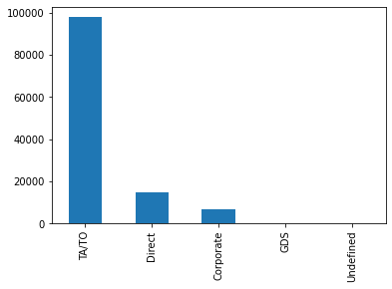
UNIVARIATE ANALYSIS
6. market_segment
7. distribution_channel

Slide 14
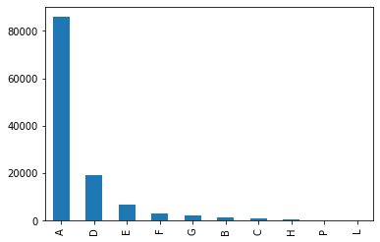
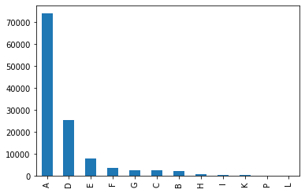
UNIVARIATE ANALYSIS
8. reserved_room_type
9. assigned_room_type

Slide 15
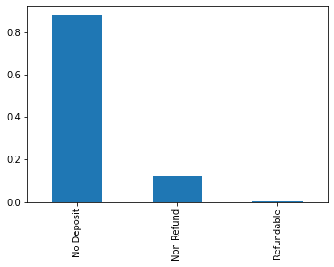
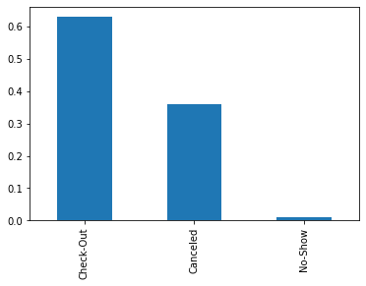
UNIVARIATE ANALYSIS
10. deposit_type
11. reservation_status

Slide 16
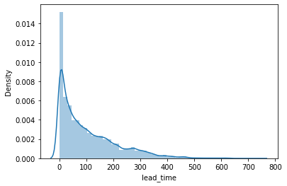
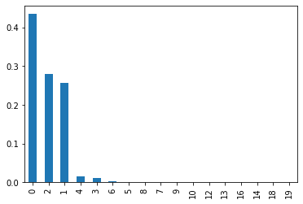
UNIVARIATE ANALYSIS
12. lead_time
13. stays_in_weekend_night

Slide 17
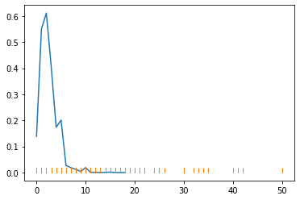
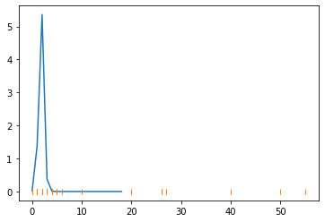
UNIVARIATE ANALYSIS
14. stays_in_week_night
15. adults

Slide 18
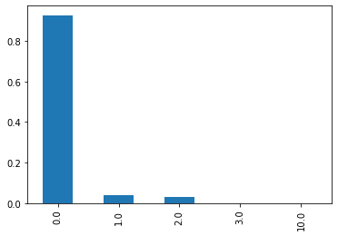
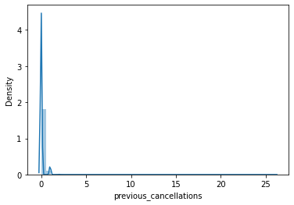
UNIVARIATE ANALYSIS
16. children
17. previous_cancelations

Slide 19

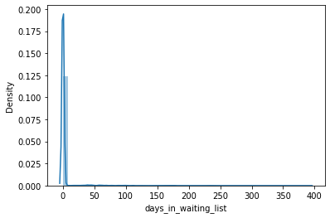
UNIVARIATE ANALYSIS
18. booking_changes
19. Days_in_waiting_list

Slide 20
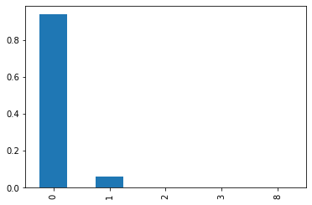
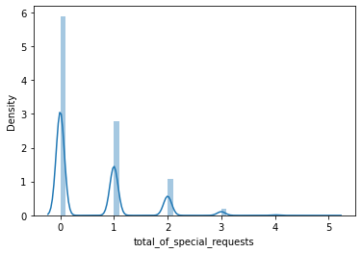
UNIVARIATE ANALYSIS
20. required_car_parking_spaces
21. total_of_special_requests

Slide 21
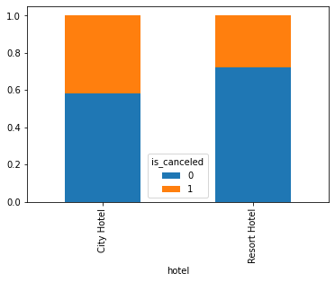
BIVARIATE ANALYSIS
1. Hotel Type Vs Cancelations
Cancelations in a City Hotel are relatively higher than those in Resort Hotel.
Approximately 40% of the booking in a City Hotel got canceled
Approximately 25% of the booking in a Resort Hotel got canceled

Slide 22
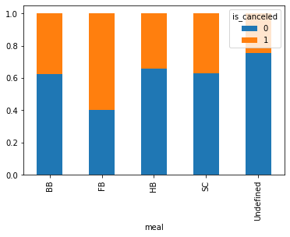
BIVARIATE ANALYSIS
2. Meal Vs Cancelations
A booking with Full Board is most likely to get canceled.
Approximately 60% of the booking with a Full Board got canceled.
Approximately 40% of the booking with “BB”, “HB” and “SC” got canceled.

Slide 23
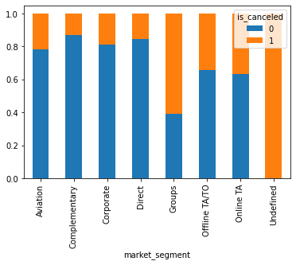
BIVARIATE ANALYSIS
3. Market Segment Vs Cancelations
Group Bookings are most likely to get canceled.
Bookings where Market Segment is Undefined, will definitely get canceled.

Slide 24
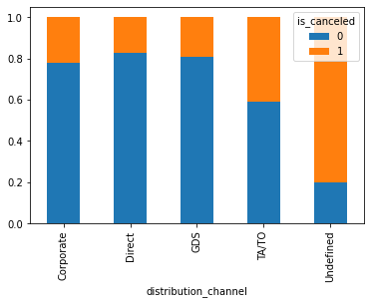
BIVARIATE ANALYSIS
4. Distribution Channel Vs Cancelations
Undefined Distribution Channel are most likely to get canceled.
TA/TO Distribution Channel have a 40% chance of getting canceled.

Slide 25
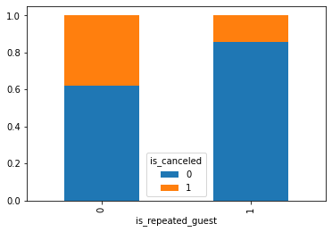
BIVARIATE ANALYSIS
5. Repeated Guests Vs Cancelations
Repeated Guests hardly have 10% chance of cancelling.
Whereas, non repeated guests have approximately 40% chances of cancelling

Slide 26
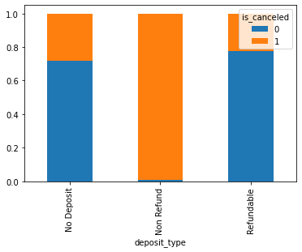
BIVARIATE ANALYSIS
6. Deposit Type Vs Cancelations
Non-refundable bookings are almost certain to be canceled. However, this looks strange.

Slide 27
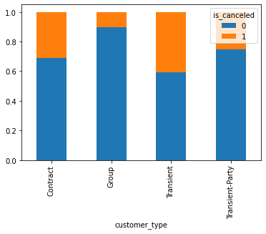
BIVARIATE ANALYSIS
7. Customer Type Vs Cancelations
Group Bookings have a very low chance of approximately 10% of cancelations.
Transient Customers have approximately 40% chances of getting canceled

Slide 28
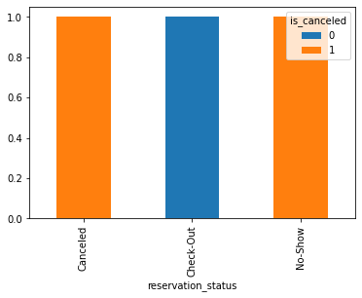
BIVARIATE ANALYSIS
8. Reservation Status Vs Cancelations
These two attributes are highly correlated
We may, thus, drop reservation_status column

Slide 29
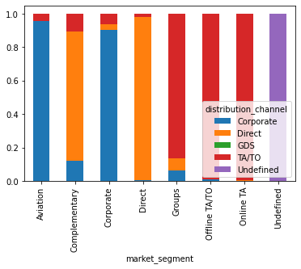
BIVARIATE ANALYSIS
9. market_segment vs distribution_channel
Market Segment and Distribution Channel are highly related
Undefined Market Segment also has undefined distribution channel
TA and TA/TO market segments are most likely to have TA/TO distribution channel
Direct market segment is most likely to have a Direct Distribution Channel as well

Slide 30
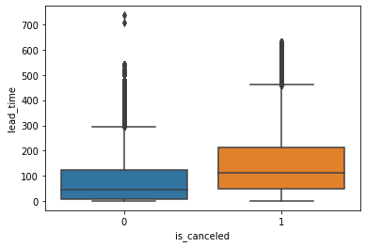
BIVARIATE ANALYSIS
9. lead_time vs is_canceled
Canceled bookings have a higher average lead_time than non-canceled bookings

Slide 31
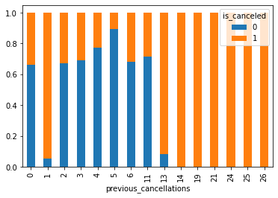
BIVARIATE ANALYSIS
9. previous_cancelations vs is_canceled
Travelers who have more than 13 cancelations in the past will certainly cancel this booking

Slide 32
BIVARIATE ANALYSIS
9. previous_cancelations vs is_canceled
Travelers who have more than 13 cancelations in the past will certainly cancel this booking

Slide 33
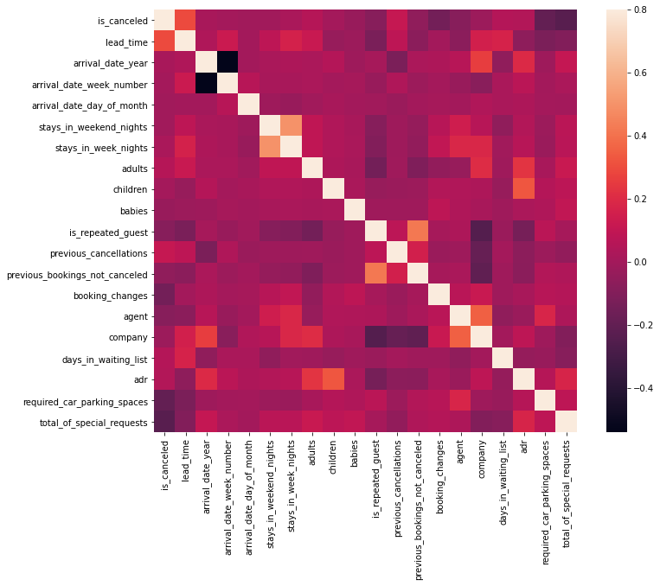
MULTIVARIATE ANALYSIS

Slide 34
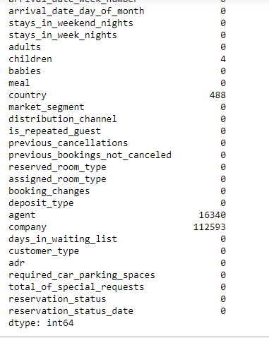
TREATING NaN VALUES
‘children’ column has 4 NaN values. These rows can be dropped
‘country’ country has 488 NaN values. These rows can also be dropped
‘agent’ column has 16340 NaN values. The contents of this column is not clear. The column is also not highly correlated to any dependent variable. Hence, we may drop this column.
‘company’ column has 112593 NaN values. The contents of this column is not clear. The column is also not highly correlated to any dependent variable. Hence, we may drop this column as well.

Slide 35
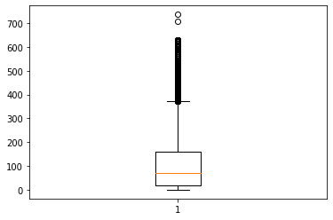
DEALING WITH OUTLIERS
1. meal
2. lead_time
This column has a value 'undefined', which is hardly 1% of the total data.
As analysed in Bivariate analysis, undefined and HB (Half Board) have similar effect on cancellations.
Thus, we replaced 'undefined' with ‘HB’
Delete values greater than 650

Slide 36
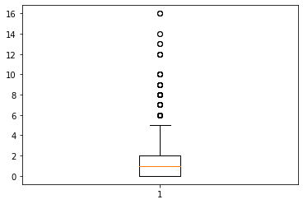
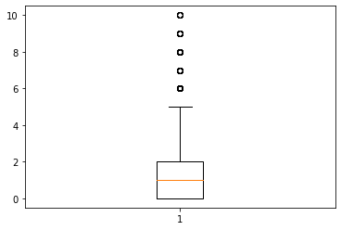
DEALING WITH OUTLIERS
3. Stays_in_weekend_nights
Remove values greater than 10

Slide 37
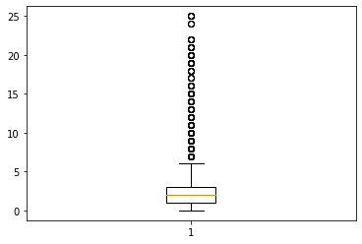
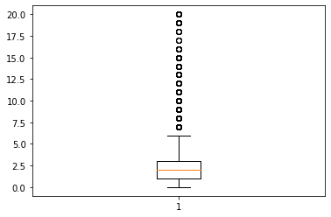
DEALING WITH OUTLIERS
4. Stays_in_week_nights
Remove values greater than 20

Slide 38
DEALING WITH OUTLIERS
5. adults
6. children
Few bookings have number of adults as high as 55. This is not a practical scenario and such entries can be dropped.
In a practical scenario, more than 4 adults cannot stay in a room
Some reservations have 10 number of children. Not a practical scenario in my opinion.
I would choose to drop such entries

